Slide 1
The Haitian Revolution

Slide 6
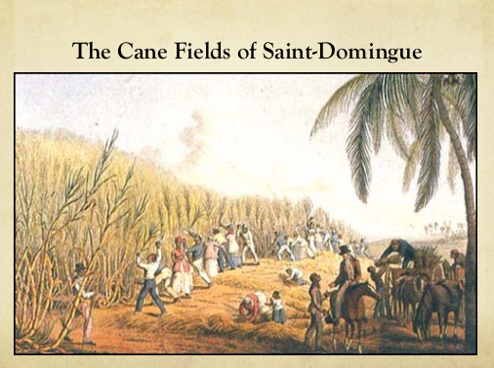

Slide 10
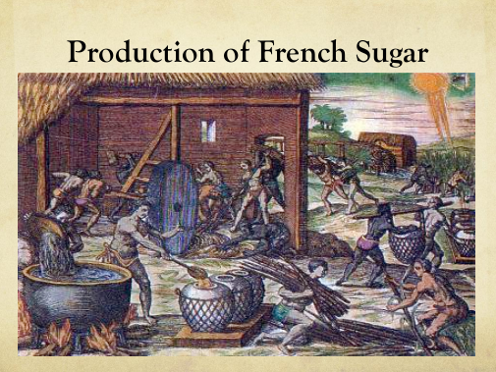

Slide 14
