Slide 1
The End of Communism
AP World History Mr. Somogye

Slide 2
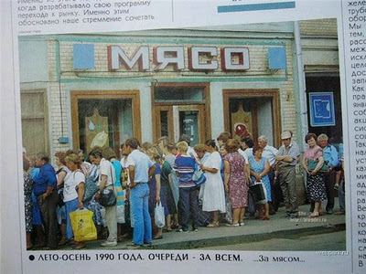
General Failures of Communism
Economic failures
By late 1970s = communist economies showed no signs of catching up to more advanced capitalist countries
Soviet economy = stagnant
People had to wait in long lines for consumer goods, which were poor in quality and declining in availability
Citizens waiting in line for goods in the Soviet Union
Photo = circa the late-1980s

Slide 3
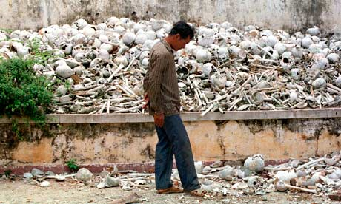
General Failures of Communism
Moral Failures
Many incidents invalidated communist claims to moral superiority over capitalism
Horrors of Stalin’s “Terror” and the gulag
Mao’s Cultural Revolution
Genocide in communist Cambodia
Simultaneously = overall global political culture was more widely embracing democracy and human rights as the intended legacy of humankind
The site of one of Cambodia’s “killing fields”

Slide 4
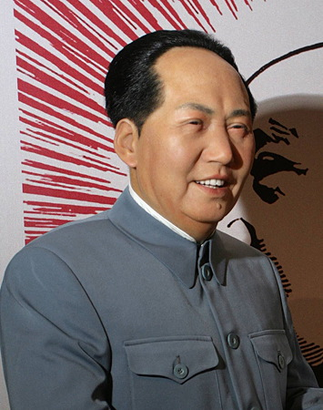
China: Abandoning Communism and Maintaining the Party
1976 = death of Mao Zedong
Successor = Deng Xiaoping
Committed to fostering political stability and economic growth
Social and political reforms:
Previously banned plays, operas, films, and translations of Western classics = allowed again
“Literature of the wounded” released = exposed the suffering of the Cultural Revolution under Mao
About 100,000 political prisoners released

Slide 5
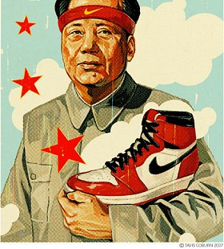
China: Abandoning Communism and Maintaining the Party
Deng Xiaoping’s economic reforms:
Dismantled collectivized farms and returned to a system of small-scale private agriculture
Managers of state enterprises given more authority and were encouraged to act like private owners
Opened China to the world economy and welcomed foreign investment
Local governments and private entrepreneurs created thousands of “township and village enterprises” that produced food, clothing, building materials, and more

Slide 6
China: Abandoning Communism and Maintaining the Party
Positive Results of Economic Reforms
Negative Results of Economic Reforms
Rapid and sustained economic growth
Better diets
Lower mortality rates
Declining poverty
Massive urban construction
Surging exports
New prosperity and increased standard of living for millions
Corruption among Chinese officials
Widening gap between the rich and the poor
Urban overcrowding
Pollution in the cities
Periodic inflation
Street crime
Prostitution
Gambling
Drug addiction
A criminal underworld

Slide 7
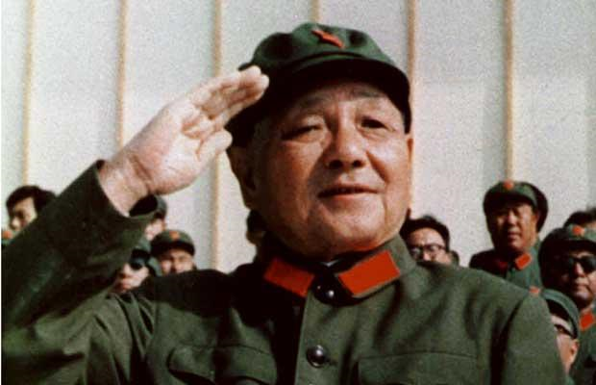
China: Abandoning Communism and Maintaining the Party
China had developed a capitalist economy, but Deng Xiaoping did NOT want to give up his political monopoly or promote democracy
Deng Xiaoping declared that democracy would lead to chaos and anarchy

Slide 8
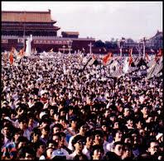
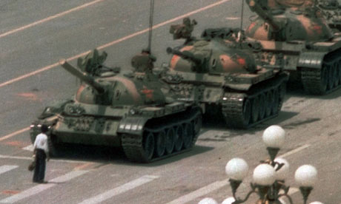
Tiananmen Square
1980s = a democracy movement led by university and secondary school students surfaced
Deng ordered the brutal crushing of this demonstration in Beijing’s Tiananmen Square
Recorded by the media → brought to television sets around the world

Slide 9
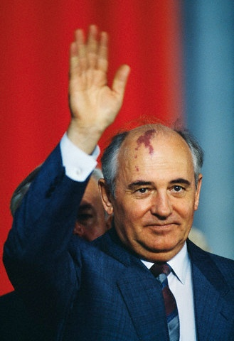
The Soviet Union: The Collapse of Communism and Country
1985 = Mikhail Gorbachev became the General Secretary of the Soviet Union
Gorbachev committed to tackling the country’s many problems
Economic stagnation
Growing black market
Public apathy
Cynicism about the Communist Party

Slide 10
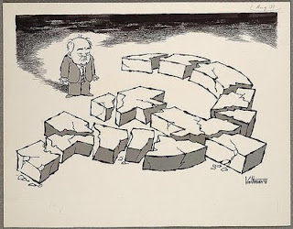
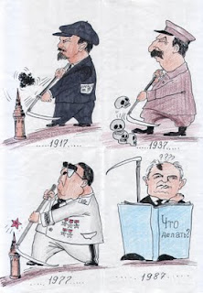
The Soviet Union: The Collapse of Communism and Country
Perestroika (Restructuring) = Gorbachev’s economic program launched in 1987
Freed state enterprises from government regulation
Permitted small-scale private businesses
Offered opportunities for private farming
Began to welcome foreign investment
Resistance to these reforms led Gorbachev to seek allies outside of his official circles

Slide 11
The Soviet Union: The Collapse of Communism and Country
Glasnost (Openness) = Gorbachev’s policy of permitting a much wider range of cultural and intellectual freedoms in Soviet life
Goal = to overcome the distrust that had grown between society and the government
The information that poured into the Soviet Union as a result of glasnost led to the mass movement towards democratization in the Soviet Union

Slide 12
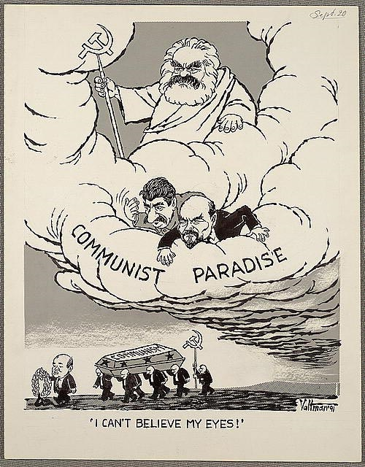
The Soviet Union: The Collapse of Communism and Country
Democratization = involved the creation of a new parliament with real powers
Would be chosen in competitive elections
1989 elections = dozens of leading communists were rejected at the polls

Slide 13
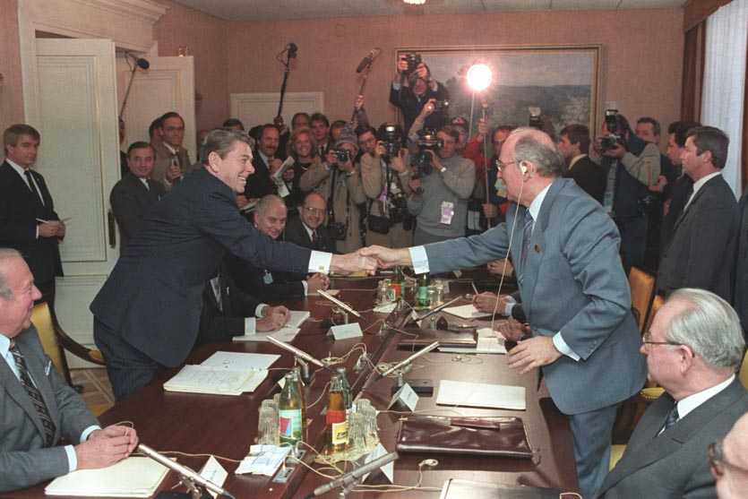
The Soviet Union: The Collapse of Communism and Country
In foreign affairs, Gorbachev moved to end the Cold War
Made cuts in Soviet military forces
Engaged in arms control negotiations with the U.S.
Refused to intervene as communist governments in Eastern Europe were overthrown
President Ronald Reagan and Mikhail Gorbachev in 1985

Slide 14
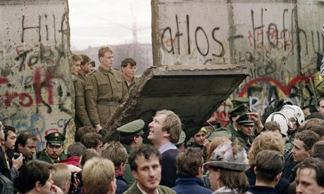
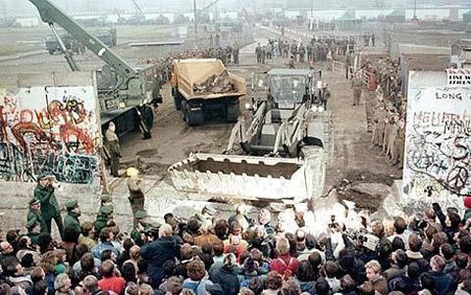
The Soviet Union: The Collapse of Communism and Country
Events in the Soviet Union influenced Eastern European nations → if the USSR could practice glasnost and hold competitive elections, why couldn’t they?
“Miracle Year” of 1989 = massive demonstrations, last-minute efforts at reforms, the breach of the Berlin Wall, and the surfacing of new political groups all overwhelmed the unpopular communist regimes of Poland, Hungary, East Germany, Bulgaria, Czechoslovakia, and Romania
Communism was swept away in Eastern Europe
This success inspired nationalists and democrats in the Soviet Union → brought the communist regime in the USSR to its end in 1991

Slide 15
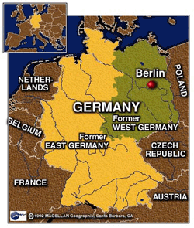
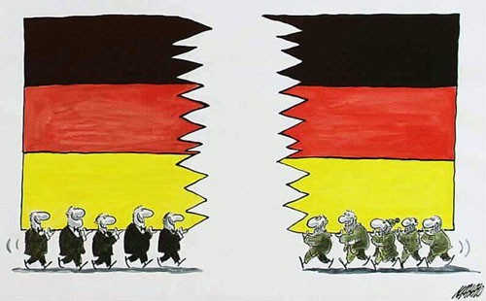
The Soviet Union: The Collapse of Communism and Country
1991 = the Soviet Union disintegrated into 15 new and independent states
1990 = reunification of Germany

Slide 16
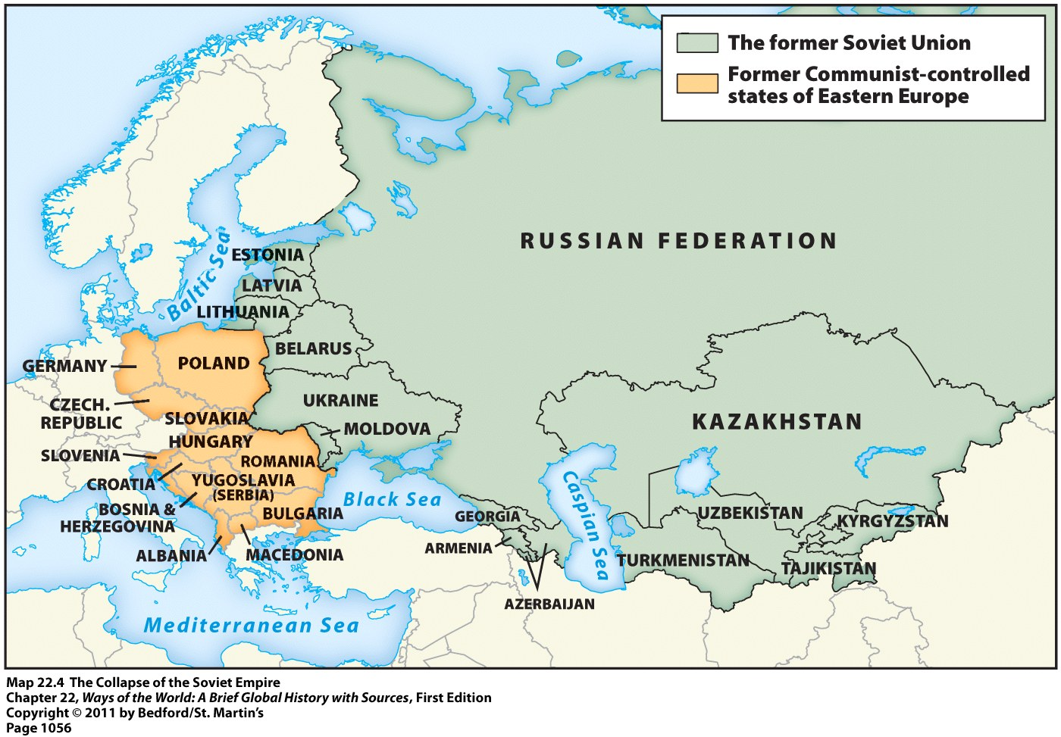
The Soviet Union: The Collapse of Communism and Country

