Slide 1
The Globalization of Environmentalism
AP World History Mr. Somogye

Slide 2
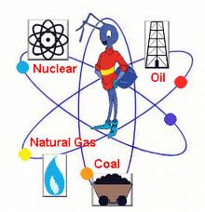
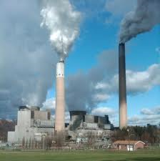
Environmental Changes
3 major factors accelerated the impact of humans on the environment in the 20th century:
Population explosion
New ability of humankind to tap the energy potential of fossil fuels → coal, oil, hydroelectricity, natural gas, nuclear power
Unprecedented economic growth as science and technology increased the production of goods and services

Slide 3
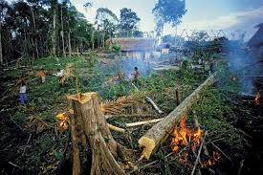
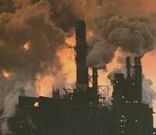
Environmental Changes
Growing numbers of the poor and growing consumption of the rich = led to the doubling of cropland and depletion of the world’s forests and grasslands
Numerous species of animals and plants = either endangered or extinct
Increased numbers of other species = ex: cattle, pigs, chickens, rats, dandelions
Massive air pollution in major cities
Thinning of the ozone layer from released CFCs

Slide 4
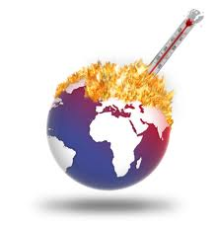
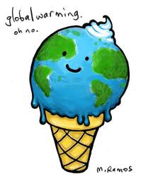
Environmental Changes
Most critical environmental transformation = global warming
Caused by two major factors:
Increased burning of fossil fuels = emit heat-trapping greenhouse gases
Loss of trees = would otherwise remove carbon dioxide from the air

Slide 5
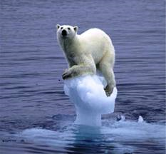
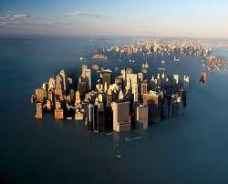
Environmental Changes
Concerns with global warming:
Melting glaciers and polar ice caps
Rising sea levels
Thawing permafrost
Extreme hurricanes
Further species extinction

Slide 6
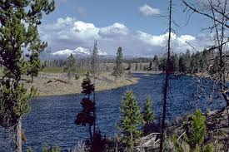
Green and Global
1st wave of environmentalism = in the 1800s in the wake of the industrial revolution
Expressed a need for “scientific management” of nature
“Wilderness idea” = aimed to preserve untouched areas from human disruption
Creation of many U.S. national parks
No mass following or large global response
Yellowstone National Park
In Wyoming
Established in 1872

Slide 7
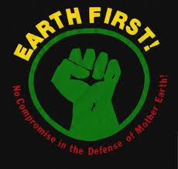
Green and Global
2nd wave of environmentalism = in the 2nd half of the 1900s
Began with the publication in 1962 of Rachel Carson’s Silent Spring
Exposed the chemical contamination of the environment that threatened both human health and the survival of many species
Generated an enormous response and launched the environmental movement in the U.S.

Slide 8
Green and Global
This environmental movement spread to other parts of the West as well
Club of Rome = a global think tank headquartered in Europe
Germany = emergence of the Green Party
Major concerns of Western environmentalists = pollution, wilderness issues, and opposition to development in untouched areas

Slide 9
Green and Global
1970s-1980s = environmental movements began in the Global South as well
Environmentalism in the West | Environmentalism in the Global South
National movement; many large national organizations | More locally based
Involved affluent members of the middle-class | Involved poor people
Engaged in political lobbying and corporate strategies | Environmental movements often overlap with other movements for political and social reform
More concerned with the rights of nature and wilderness protection | More concerned with issues of: food security, health, and basic survival
Relatively nonviolent movement | Movements occasionally become violent → guerrilla warfare actions by “green armies”

Slide 10
Green and Global
Late 20th century = environmentalism became a global concern
Led to the global “green revolution”
Legislation passed in many countries to limit air pollution
Pushed many businesses in a “green” direction
Fostered research on alternative and renewable resources
Stimulated UN conferences on global warming
Persuaded millions of people to “go green” and alter their way of life
Generated many international agreements addressing issues such as ozone depletion and global warming

Slide 11
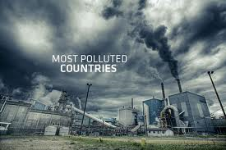
Green and Global
Major conflict between the Global North and Global South = developing countries often feel that Northern initiatives to address atmospheric pollution and global warming will prevent their industrial development
Global South pushed to limit its emissions to cut down on pollution, but they didn’t create that pollution in the first place
Shouldn’t the industrialized countries accept more responsibility?

Slide 12
Results of Global Environmentalism
“One world” thinking
Focus on the common plight of humankind
Marked a challenge to modernity
Ideas of sustainability and restraint entered global discussions

