Slide 1
The Transformation of the World Economy
AP World History
Mr. Somogye

Slide 2
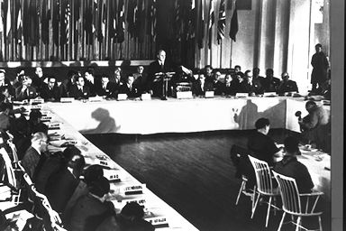
The Transformation of the World Economy
Economic globalization began to accelerate quickly following World War II
1944 = Bretton Woods Conference
Held by the capitalist victors (led by the U.S.)
Goal = to avoid a worldwide depression like the one following WWI
Created many international agreements and institutions to maintain a strong global economy
World Bank
International Monetary Fund
Photograph of delegates at the Bretton Woods Conference

Slide 3
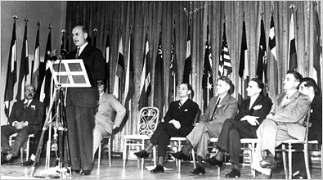
The Transformation of the World Economy
This “Bretton Woods system” did the following:
Negotiated the rules for commercial and financial dealings among the major capitalist countries
Promoted free trade
Stabilized currency values and linked them to the U.S. dollar
Promoted high levels of capital investment
Pictured above: Treasury Secretary Henry Morgenthau speaking at the opening of the Bretton Woods conference on July 8, 1944.

Slide 4
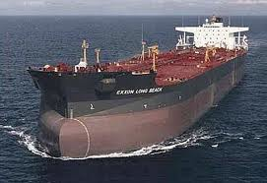
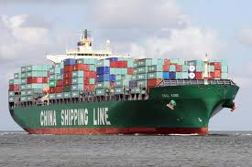
The Transformation of the World Economy
Several new technologies developed in the 2nd half of the 20th century contributed to the acceleration of economic globalization:
Containerized shipping
Huge oil tankers
Air express services
Fiber-optic cables
Internet

Slide 5
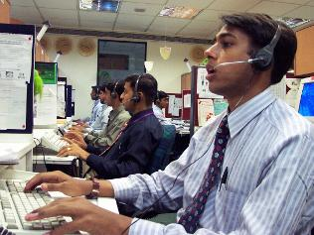
The Transformation of the World Economy
Entire world = increasingly seen as one single market
Neo-liberalism = an approach to the world economy that favors:
Reduction of tariffs
Free global movement of capital
A mobile and temporary workforce
Privatization of state-run enterprises
Stopping government efforts to regulate the economy
Cuts in taxes and government spending
A call center in India

Slide 6
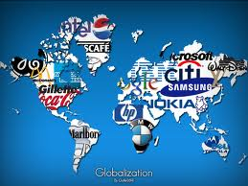
Reglobalization
The world began to “reglobalize” after WWII, following the contractions of the 1930s
Involved the accelerating circulation of:
Goods
Capital (money and investments)
People

Slide 7
Circulation of Goods
As world trade skyrocketed, an increased number of goods began to circulate around the globe
Supermarkets, stores, and so on now stock their shelves with products from every part of the globe

Slide 8
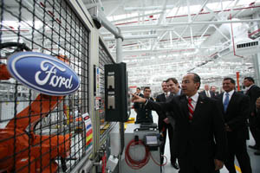
Circulation of Money
Money has become extremely mobile in three major ways:
Foreign direct investment = when a company or firm in one country opens a factory in another country
- Rich countries and companies are always after: cheap labor, tax breaks, and looser environmental regulations
Ford recently opened a new engine plant just outside of Mexico City

Slide 9
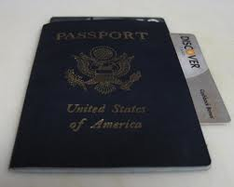
Circulation of Money
2) Short-term movement of capital = when investors buy foreign currencies or stocks likely to increase in value and sell them quickly thereafter
3) Personal funds of individuals = international credit cards, transfer of money across international borders, etc.

Slide 10
Transnational Corporations
Transnational Corporations (TNCs) = global businesses that produce goods or deliver services simultaneously in many countries
Example: Mattel Corporation’s Barbie doll made in factories in Indonesia and China, using molds from the U.S., plastic and hair from Taiwan and Japan, and cotton cloth from China

Slide 11
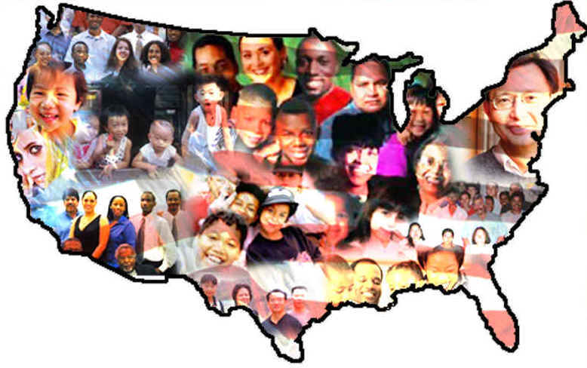
Circulation of People
Increasing numbers of people continue to migrate seeking work, a better life, or refuge from political oppression or civil war at home
Example #1: Mexicans, Cubans, and Haitians in the United States
Example #2: Highly educated professionals (doctors, engineers, etc.) leaving the Global South for more developed countries

Slide 12
Circulation of People: A Quick Glance at the U.S.
Benefits
Problems
Many of these workers provide much needed and sought after skills, services, intelligence, etc. → think about doctors from India, engineers from China, and so on → this can boost the U.S. economy
Workers able to provide for their families back home
Maintains tradition of the U.S. as a land of opportunity to all, melting pot, culturally rich and diverse society, etc.
Many workers migrate illegally → receive the benefits of U.S. government services, but don’t pay taxes
Cheap source of labor can take away jobs from legal citizens
Increased political and cultural tensions
Increased prejudice, discrimination, racism, conclusions founded upon stereotypes, etc.
Overpopulation

Slide 13
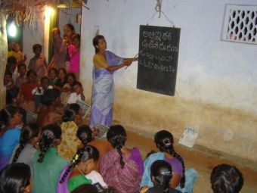
Growth, Instability, and Inequality
Economic globalization has helped generate the most remarkable increase in economic growth and creation of wealth in world history
Value of total world output in 1950 = $7.1 trillion
Value of total world output in 2003 = $55.9 trillion
Positive impacts on human welfare:
Growth in life expectancies
Declining infant mortality rates
Increasing literacy
Falling world poverty

Slide 14
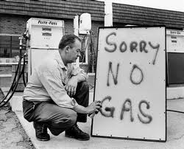
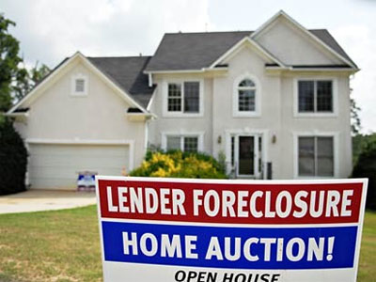
Growth, Instability, and Inequality
Economic globalization has also created worldwide economic instability
Example #1: 1973-1974 = oil shortage → rising oil prices → stock market crash → economic hardships for both developed and developing countries
Example #2: 2008 = inflated housing market in U.S. collapsed → millions of home foreclosures → banks closing → growing unemployment → tightening of credit → declining consumer spending

Slide 15
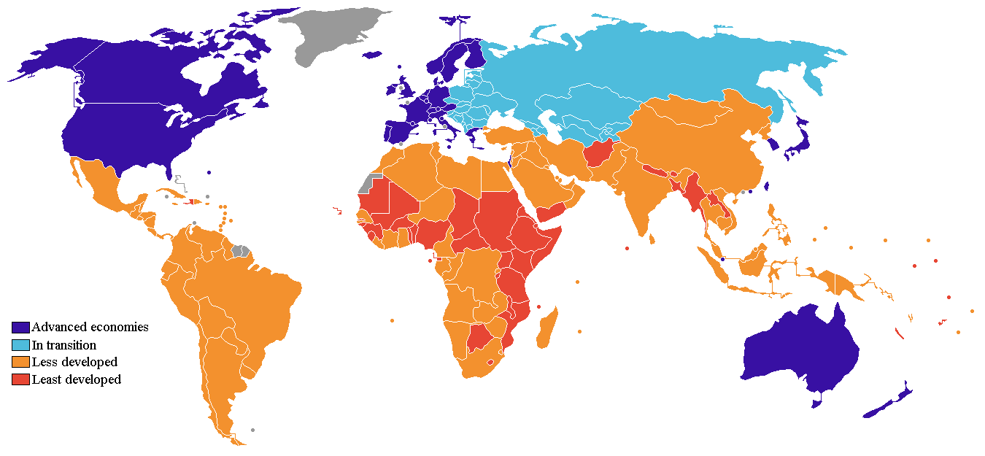
Growth, Instability, and Inequality
Economic globalization increased the gap between the Global North and the Global South
Clear division in the human community = the rich industrialized countries (mostly in Europe and North America) versus everyone else

Slide 16
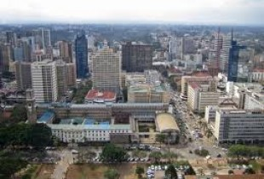
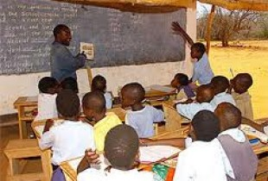
Growth, Instability, and Inequality
This widening gap has been evident in great differences in:
Incomes
Medical care
Availability of clean drinking water
Educational and employment opportunities
Access to the Internet

Slide 17
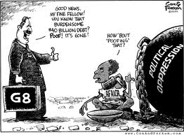
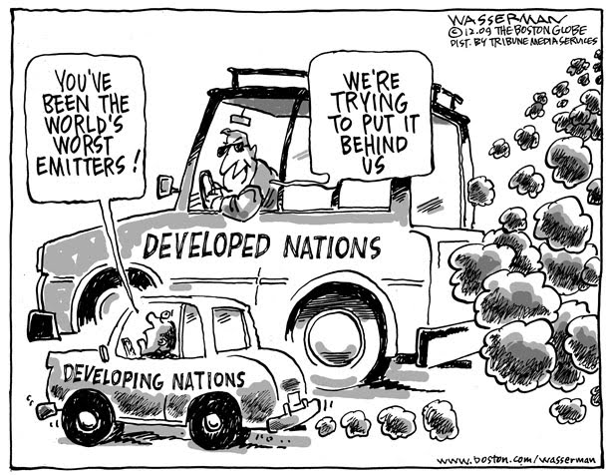
Growth, Instability, and Inequality
Contentious economic issues between the Global North and the Global South:
Rules for free trade
Availability of and terms for foreign aid
Representation in international economic organizations
Growing problem of indebtedness
Environmental and labor standards

Slide 18
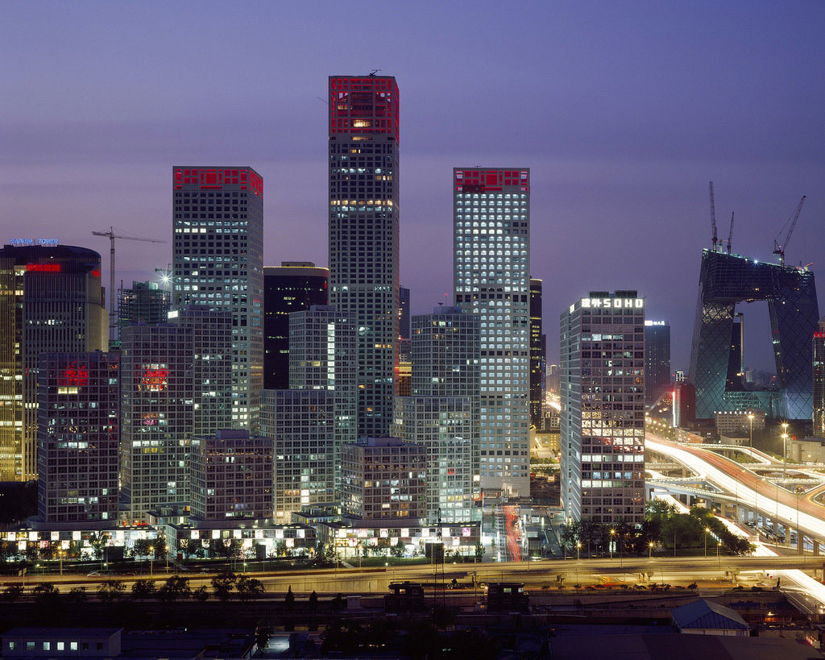
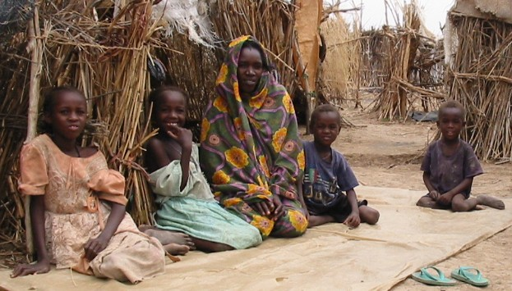
Growth, Instability, and Inequality
Inequalities among developing countries themselves have also delayed reforming the world economy in favor of the poor
Example #1: Oil-rich nations in the Middle East versus banana-producing countries of Central America
Example #2: Rapidly industrializing states of China and India versus impoverished African countries
Beijing, China
Darfur, Sudan

Slide 19
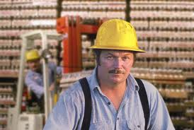
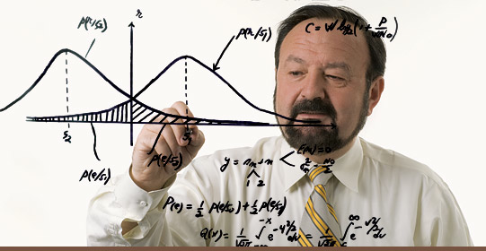
Growth, Instability, and Inequality
Economic globalization has also created inequalities within individual nations
U.S. = gap between unskilled Americans (manufacturing and low-wage service sector jobs) versus skilled Americans
Mexico = gap between urban, industrial north and rural, agricultural south
China = gap between rural households and those in the growing cities

Slide 20
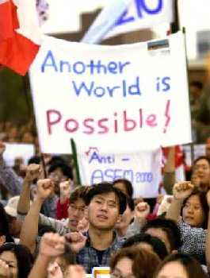
“Antiglobalization” Movement
1990s = creation of an international coalition comprised of many different groups of people from rich and poor countries alike
Opposed to neo-liberal globalization

Slide 21
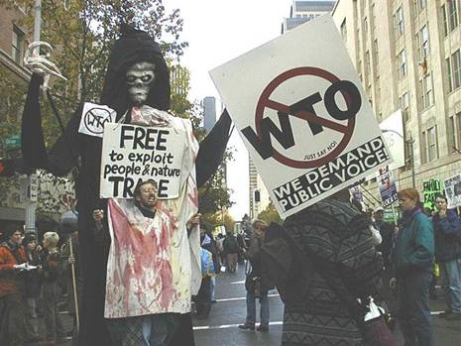
“Antiglobalization” Movement
Agree that economic globalization has:
Lowered labor standards
Devastated the environment
Prevented poor countries from protecting themselves against financial speculators
Ignored local cultures
Disregarded human rights
Enhanced global inequality
Favored only the interests of large corporations and rich countries
Antiglobalization Activists

Slide 22
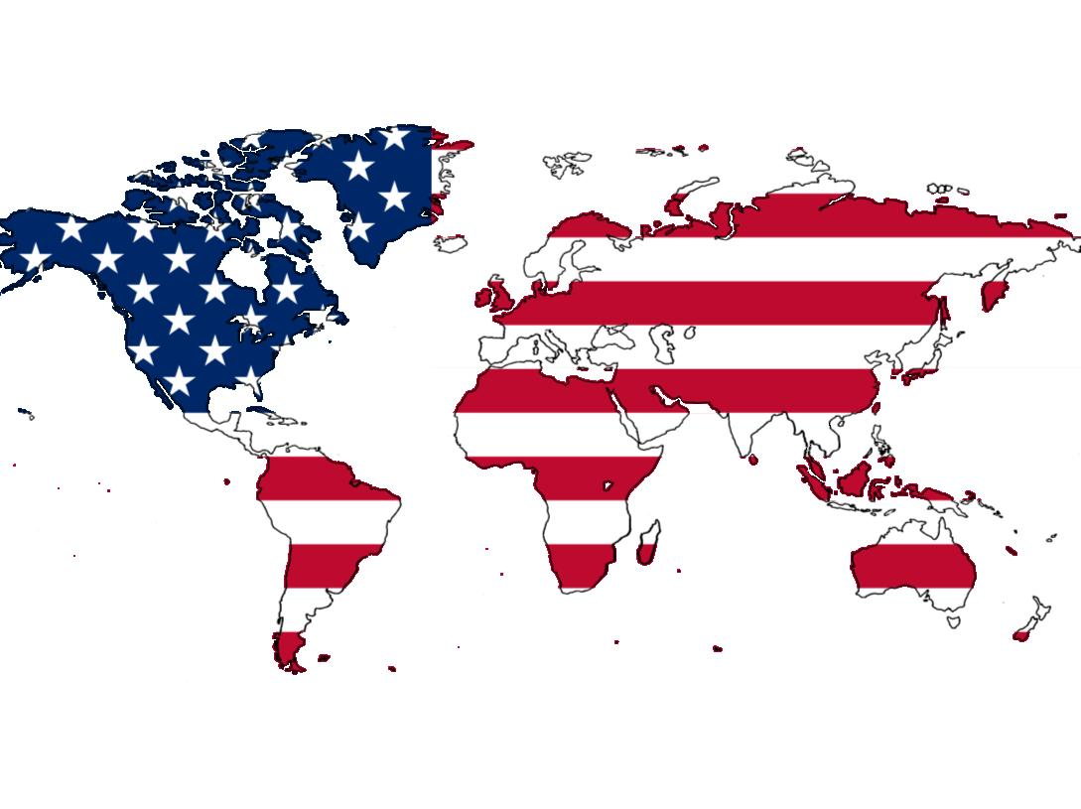
Globalization and an American Empire
U.S. global presence = can be seen as an “informal empire”
Goal = to create societies and governments compatible with the values and interests of the U.S. using:
Economic power
Political pressure
Military action (if necessary)
No direct control over large populations or territories for long periods of time

Slide 23
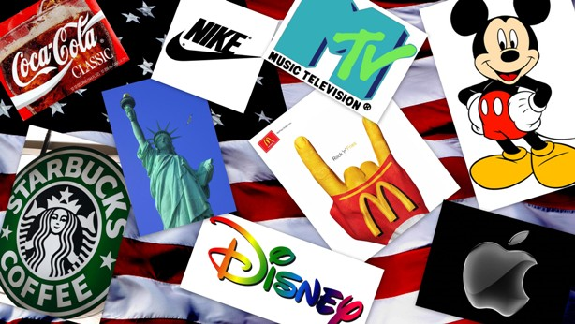
Globalization and an American Empire
U.S. = an “empire of production”
Uses its wealth to entice or intimidate potential collaborators
“Soft power” of the U.S.:
Cultural attractiveness
Political and cultural freedoms
Economic benefits of cooperation
General willingness of many to follow the American lead voluntarily

Slide 24
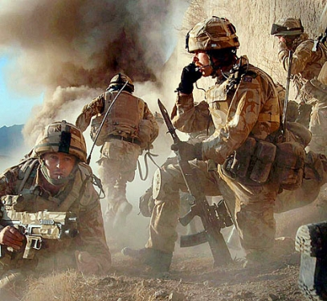
Globalization and an American Empire
U.S. also has military dominance now unchecked by any equivalent power
Since the collapse of the Soviet Union
Illustrated best with the American invasions of Afghanistan in 2001 and Iraq in 2003
U.S. troops in Afghanistan

Slide 25
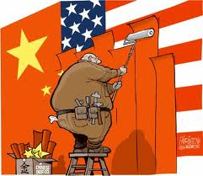
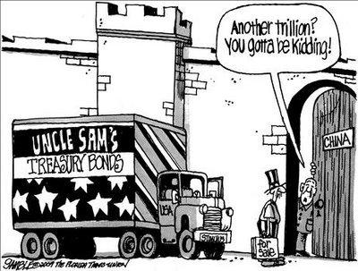
Economic Decline of the U.S.
Growing international competition from China, Japan, Taiwan, etc.
U.S. share of world production in 1945 = 50%
U.S. share of world production in 2008 = 8.1%
Reversal in America’s trade balance → imports now greatly exceed exports
U.S. = once the world’s leading creditor/lender → now the leading debtor

