Slide 1
Independence and Development in the Global South
AP World History
Mr. Somogye

Slide 2
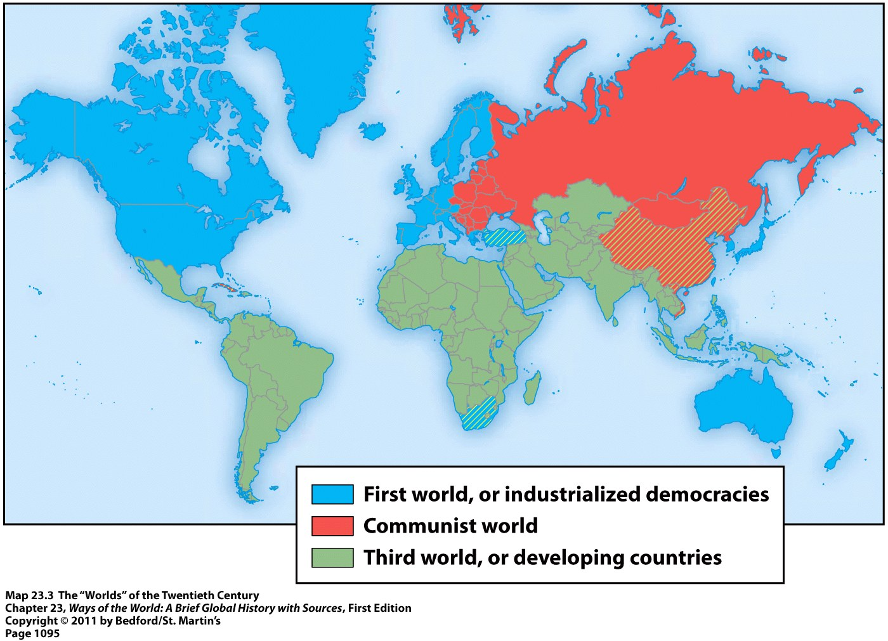
The Global South
“The Global South” = formerly labeled “third-world countries” during the Cold War → now often referred to as “developing nations”
“Decolonization” = term for the Global South’s independence from European rule

Slide 3
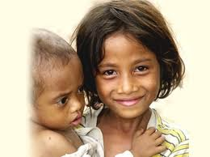
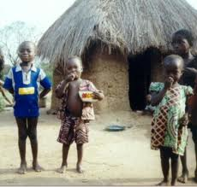
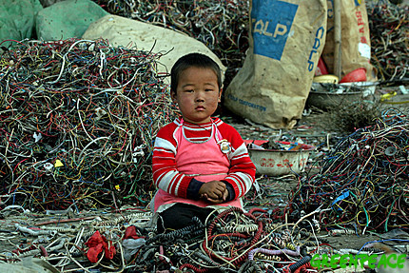
The Global South
Challenges facing the Global South after decolonization:
The legacies of empire
Deep divisions of language, ethnicity, religion, and class
Rapidly growing populations
Competing demands of the capitalist West and the communist East
Developing economies, stable politics, and coherent nations all at the same time

Slide 4
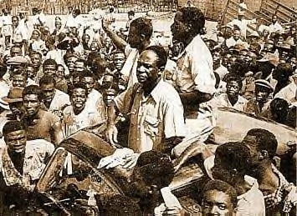
The End of Empire in World History
Dissolution of empires = nothing new
Think about the end of older empires → Assyrians, Greeks, Romans, Arabs, Mongols, etc.
What’s different about the end of these empires?
Mobilization of the masses within the colonies around a nationalist ideology
Creation of a large number of independent nation-states following the empire’s breakdown → each claiming an equal place in the world
Kwame Nkrumah after leaving prison in 1951
Led Ghana to national
independence in 1957

Slide 5
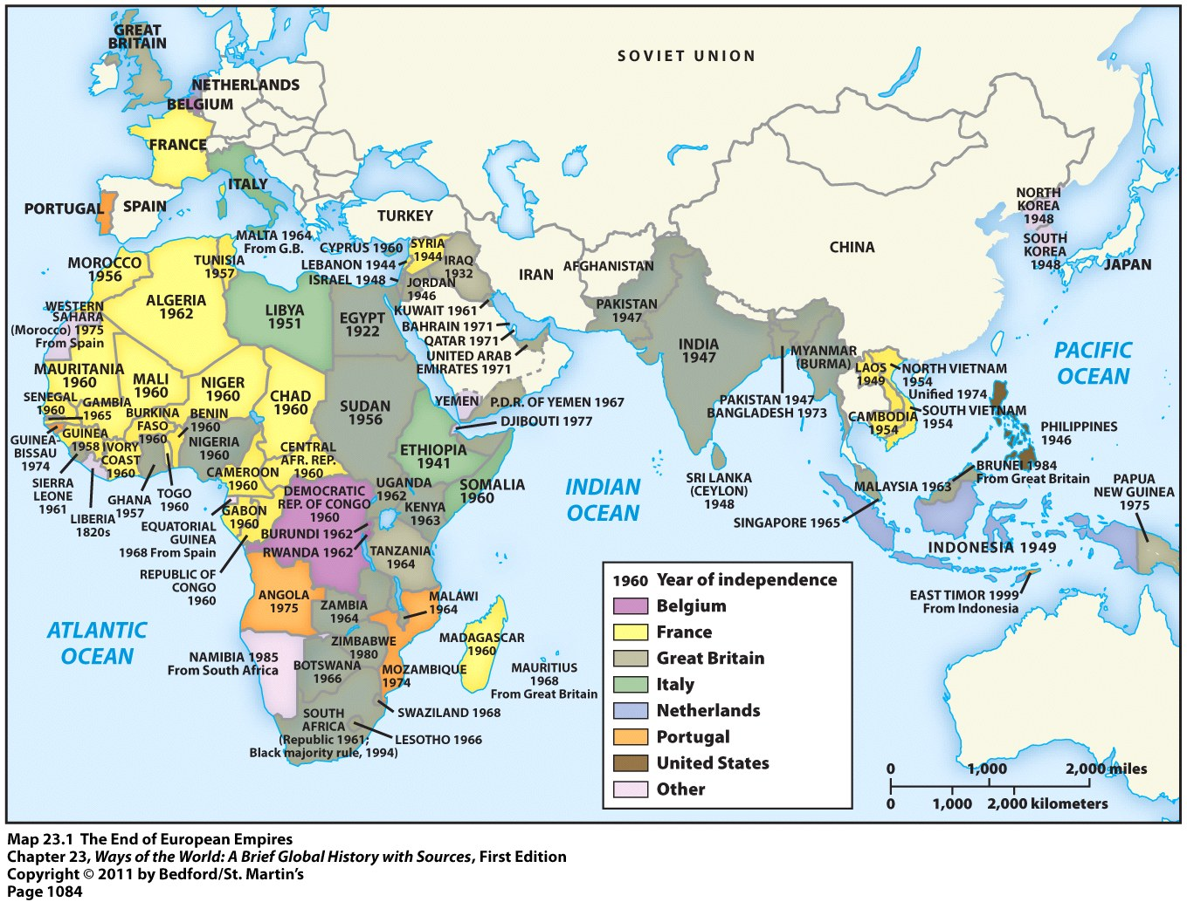
Nation-States Created

Slide 6
Explaining African and Asian Independence
The “Contradictions” Explanation = fundamental contradictions existed within the entire colonial enterprise that made its demise inevitable
Views Held by European Rulers | What’s Happening in their Colonies
Christianity and material progress | Racism, exploitation, and poverty
Increasingly democratic values | Rule by dictatorships
National self-determination | Denied any opportunities to express their own national character

Slide 7
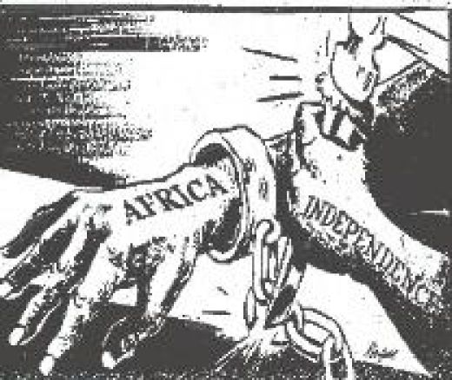
Explaining African and Asian Independence
International circumstances that led to the end of these empires:
Both world wars = weakened Europe
Both world wars = discredited any sense of European moral superiority
U.S. and Soviet Union = new global superpowers = opposed the older European colonial empires
United Nations = platform from which nations could express anticolonial views

Slide 8
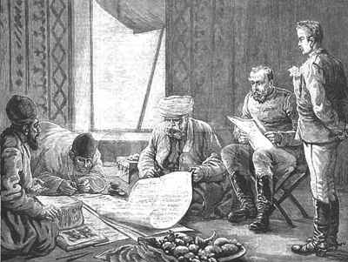
Explaining African and Asian Independence: Economic and Social Circumstances
By the mid-20th century = 2nd and 3rd generation Western-educated elites (mostly male) had arisen throughout the colonial world
Familiar with European culture and aware of the gaps between its values and its practices
Didn’t see colonial rule as a vehicle for their peoples’ progress
Increasingly insisted on independence

Slide 9
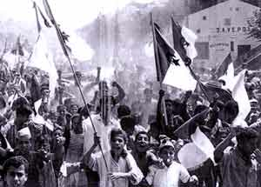
Explaining African and Asian Independence: Economic and Social Circumstances
Other groups that believed independence held promise:
Veterans of the world wars
Young people with some education but no job opportunities
Urban workers = aware of their exploitation
Small-scale traders = resentful of European privileges
Rural dwellers = lost land or suffered from forced labor
Poor and insecure newcomers to the cities
Decolonization of India

Slide 10
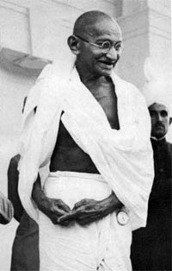
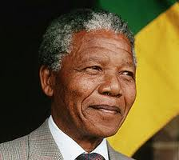
Explaining African and Asian Independence
The “Agency” Explanation = focuses on particular groups or individuals whose deliberate actions brought down the colonial system
“Agency” = deliberate initiatives of historical actors

Slide 11
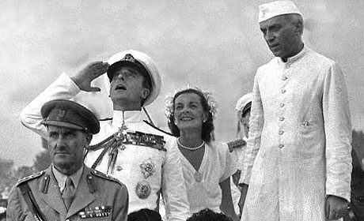
Explaining African and Asian Independence
In some areas, the colonial rulers themselves got involved and actively planned for decolonization
Negotiated settlements
Invested in infrastructure
Helped form constitutions and set up elections
In most areas, however, independence was a struggle
Variations in struggles for independence:
Length of time = a few years vs. decades
Approach = nonviolence vs. violent guerrilla warfare
Jawarhalal Nehru and Lord Mountbatten of England

Slide 12
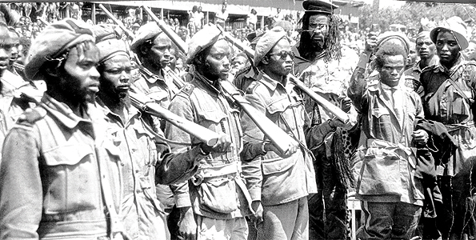
Explaining African and Asian Independence
Commonalities in struggles for independence:
Gradual involvement of ordinary people, not limited to just the leaders and educated few
A highly contested process
Efforts were rarely cohesive movements of uniformly oppressed people
Conflicting groups and parties
Different classes, ethnic groups, religions, regions, etc.
Struggled with one another over leadership, power, strategy, ideology, and the distribution of material gains
Freedom Fighters in Kenya

Slide 13
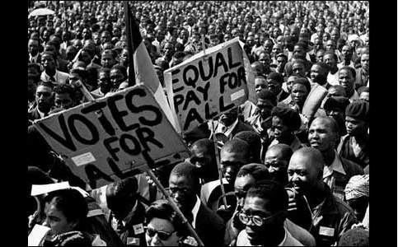
Ending Apartheid in South Africa
Freedom struggle in South Africa = against an internal opponent, NOT an occupying colonial power
South Africa = independent since 1910
Independence granted to the white settler minority
Economically prominent = whites of British descent
Politically dominant = Boers or Afrikaners = white descendants of early Dutch settlers from the 1600s
Black African majority = had no political rights at all

Slide 14
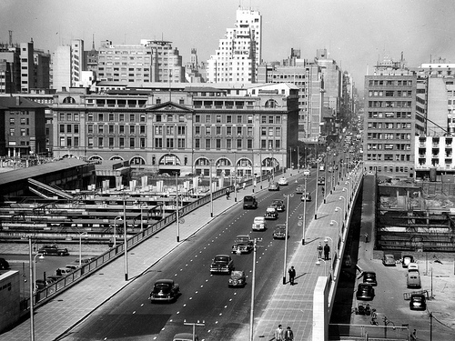
Ending Apartheid in South Africa
Unlike India, South Africa had developed a mature industrial economy by the mid-1900s
Black Africans dependent upon this white-controlled economy → worked in urban industries, mines, or on white-owned farms
This dependence made them compliant with repressive actions of the colonial rulers
Only benefit = could threaten to collectively withdraw their labor
Johannesburg, South Africa (1952)

Slide 15
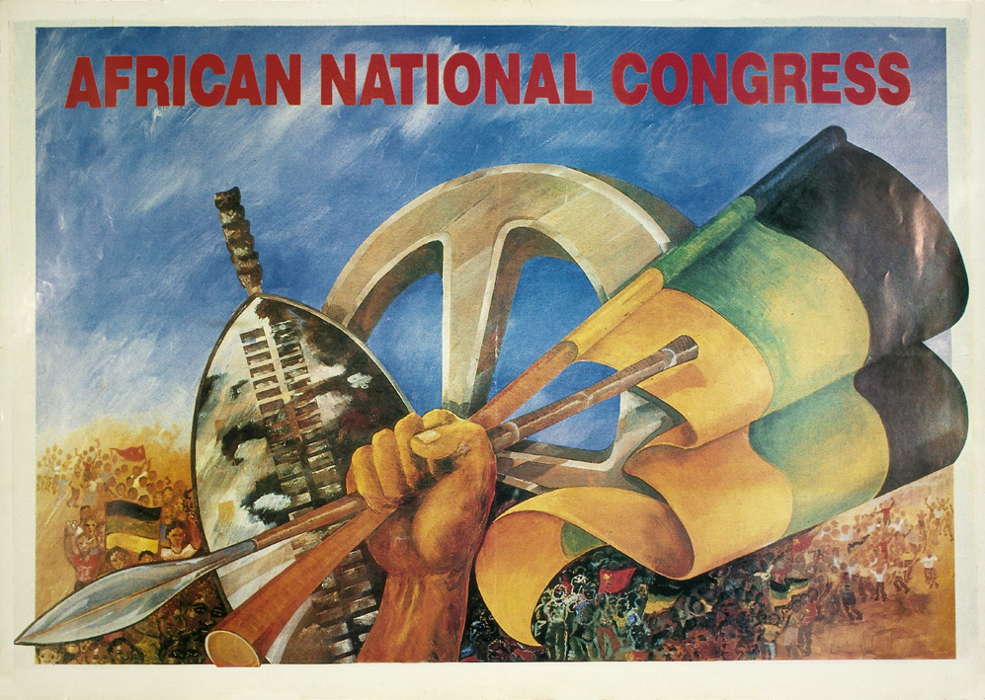
The African National Congress
African National Congress (ANC) = established in 1912
Association of educated, professional, and middle-class Africans
Original goal = to be accepted as “civilized men” within the existing order, NOT to overthrow it
Pursued peaceful and moderate protest for about 40 years = petitions, multiracial conferences, representatives appealing to the authorities
It became clear that these methods weren’t working

Slide 16
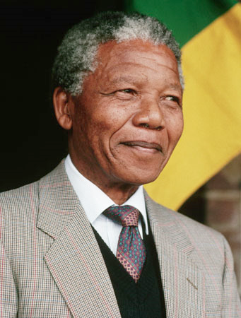
The African National Congress
1950s = ANC had new and younger leadership, which included Nelson Mandela
Broadened base of support
Nonviolent civil disobedience = boycotts, strikes, demonstrations, burning of black African passes

Slide 17
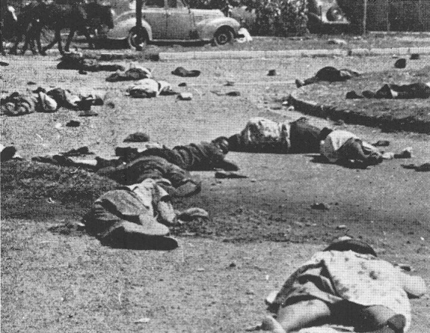
The African National Congress
Responses by the South African government:
Increased repression → including shooting at unarmed demonstrators
Banned the ANC
Imprisoned ANC leaders, including Nelson Mandela
Banned all other major political parties
Sharpeville, South Africa (1960)
For 2 days, police machine-gunned unarmed crowds protesting apartheid

Slide 18
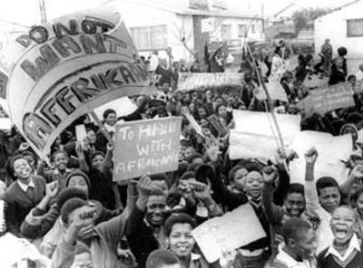
The Freedom Struggle Intensifies
Underground nationalist leaders turned to armed struggle
Organized acts of sabotage and assassination; prepared for guerrilla warfare
Black Consciousness Movement = an effort to foster pride, unity, and political awareness among South Africa’s black African majority
Mostly made up of student groups
1976 = explosion of protest in Soweto (outside of Johannesburg)
Segregated and impoverished black neighborhood
Hundreds were killed

Slide 19
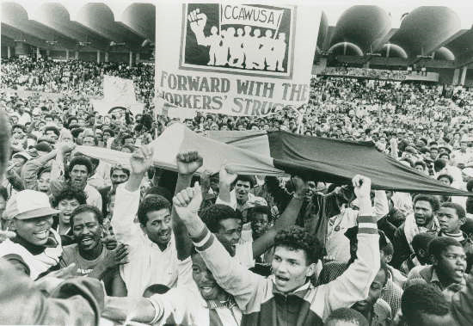
The Freedom Struggle Intensifies
Momentum from the protest in Soweto continued
Spreading urban violence and radicalization of urban young people
Mid-1980s = government declared a state of emergency
1986 (to commemorate 10th anniversary of Soweto uprising) = Congress of South African Trade Unions organized a mass strike involving about 2 million workers

Slide 20
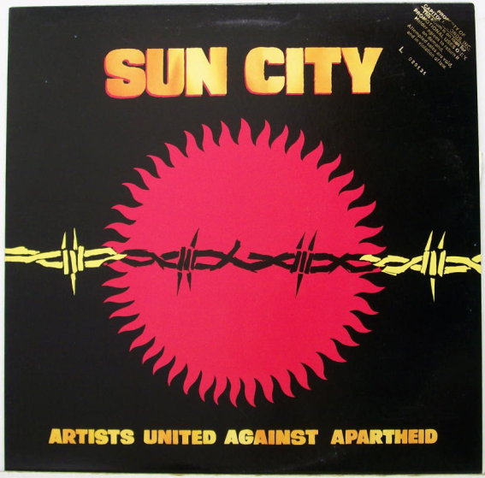
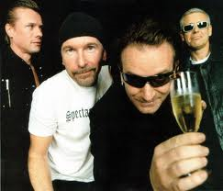
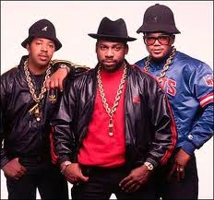
International Pressure to End Apartheid
South Africa was excluded from most international sporting events, including the Olympics
Artists and entertainers refused to perform in South Africa
Many countries enacted economic boycotts
Many countries withdrew their private investment funds
All of these factors isolated South Africa from the world

Slide 21
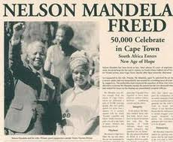
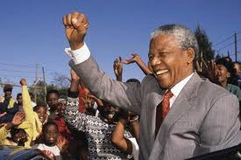
The End of Apartheid
Late 1980s = White South African leaders agreed to a process of negotiations with African nationalist leaders that led to:
The abandonment of apartheid policies
The release of Nelson Mandela from prison
The legalization of the ANC
National elections in 1994
Brought the ANC to power
Nelson Mandela = new president of South Africa

