Slide 1
Religion and Global Modernity
AP World History
Mr. somogye

Slide 2
Religion and Global Modernity
Despite modernity and science, religion has played a powerful role in the last century
4 major religious trends:
Further spread of major world religions
Resurgence of religions in new forms
Opposition of religions to elements of a secular and global modernity
Religions’ political role as a source of community identity and conflict

Slide 3
Religion and Global Modernity
Examples of the further spread of religions:
Buddhist ideas like meditation and yoga became very popular in the West
Christianity spread widely in: non-Muslim Africa, South Korea, parts of India, and China
Millions of migrants from the Islamic world planted their religion solidly in the West

Slide 4
Fundamentalism on a Global Scale
Fundamentalism = one type of religious response to the modernizing and globalizing world
Strict religious devotion that is defensive, assertive, and exclusive
Fundamentalism emerged because many religions felt threatened by features of the modern world:
Scientific and secular focus of modernity challenged the core beliefs of supernatural religion
Social upheavals connected with globalization = upset the traditional class, family, and gender relationships valued by many religions
Nation-states (often associated with certain religions) = undermined by the global economy and influence of “alien” cultures

Slide 5
Fundamentalism on a Global Scale
Tactics used by fundamentalists to communicate their message:
Educational and propaganda efforts
Political mobilization of their followers
Social welfare programs
Sometimes violence → terrorism

Slide 6
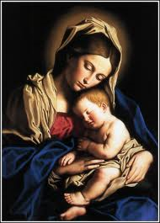
Christian Fundamentalists in the U.S.
Outraged with: “scientific” and critical approaches to the Bible, Darwinian evolution, and liberal versions of Christianity
Wanted to get back to the “fundamentals” of Christianity
Literal truthfulness of the scriptures
Belief in the virgin birth and physical resurrection of Jesus
Belief in miracles
Came to oppose:
Political liberalism and “big government”
The sexual revolution of the 1960s
Rights for the LGBT community
Abortion rights

Slide 7
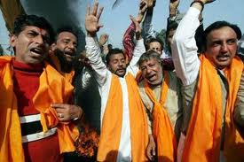
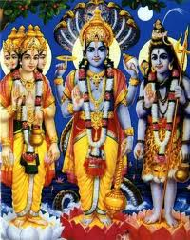
Hindu Fundamentalists in India
Known as the Hindutva movement = Hindu nationalism
Believed India was, and had always been, a Hindu land
Goal for India = to make it a purely Hindu nation again with a Hindu-based government
Opposed the existence of other religions, beliefs, etc. in India
Christians, Muslims, Sikhs, Secularists

Slide 8
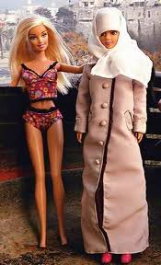
Resistance and Renewal in the World of Islam
Disappointments within the Muslim world that fueled Islamic renewal:
“Western” and secular policies not successful → created overcrowded cities with few services, widespread unemployment, pervasive corruption, slow economic growth, and a widening gap between the rich and poor
Issues with the West that fueled Islamic renewal:
A foreign presence still existed in the Muslim world even after decolonization → example: the creation of Israel in 1948
Increasing presence of Western culture that was offensive → Barbie dolls, alcohol, scantily clad women, American movies, secular schools, etc.
Soldiers in Iran disposing of illegal alcohol

Slide 9
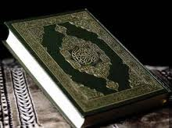
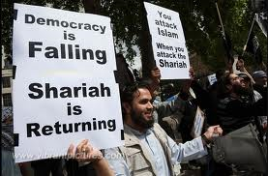
Resistance and Renewal in the World of Islam
Argument = the departure from Islamic principles had led the Islamic world into decline and subordination to the West
Goal = to return to the “straight path of Islam” and use the Quran and sharia (Islamic law) as a guide

Slide 10
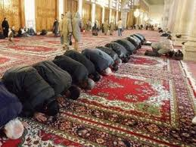
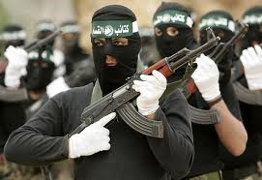
Resistance and Renewal in the World of Islam
Various expressions of Islamic renewal:
In their personal lives, many people = became more religiously observant, attended mosque, prayed regularly, fasted, etc.
Many women = adopted modest Islamic dress and the veil voluntarily
Many governments = sought to anchor themselves in Islamic rhetoric and practice
Creation of Muslim organizations that operated to provide social services that the state offered inadequately
Islamic activists = took leadership roles in unions and professional organizations
Another expression of Islamic renewal = sought the violent overthrow of what they saw as “compromised” regimes in the Muslim world

Slide 11
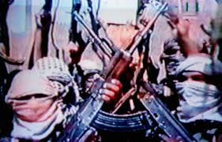
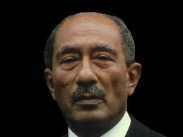
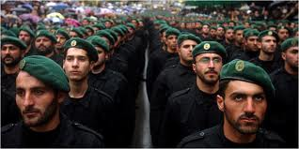
Examples of Violent Muslim Fundamentalists
Egyptian Islamic Jihad = assassinated President Anwar Sadat (1981) because of his breakdown on Islamic and Islamic opposition groups
Radical Islamic groups in Mecca = sought the overthrow of the Saudi government because of its modernity, relationship with the West, and un-Islamic lifestyle
Hamas in Palestine & Hezbollah in Lebanon = target Israel because they believe its existence is illegitimate

Slide 12
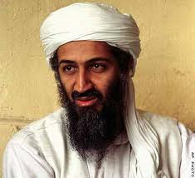
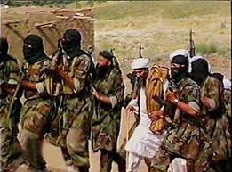
Examples of Violent Muslim Fundamentalists
Al-Qaeda = created by Osama bin Laden
Grew more radical when his homeland (Saudi Arabia) allowed the stationing of “infidel” U.S. troops in Islam’s holy land during and after the first American war against Iraq in 1991
Mid-1990s = he found a safe haven in Taliban-ruled Afghanistan
Great enemies of al-Qaeda = not Christianity itself or even Western civilization, but:
Irreligious Western-style modernity
U.S. imperialism
An American-led economic globalization

